Slide 1

Ames Iowa Housing Analysis
Group 1
Don, Grace, Jocelyn, Junyuan, Randy

Slide 2
TABLE OF CONTENTS
04
01
Feature Engineering
Introduction
05
Evaluation of Regression Models
Problem Statement
02
Conclusion
Exploratory Data Analysis
06
03

Slide 3

INTRODUCTION
In this Kaggle challenge,we are to use the well known Ames housing data to create a regression model that predicts the price of houses in Ames.

Slide 4
PROBLEM STATEMENT
Identify
the best model to achieve the lowest RMSE scores and
the top 3 predictors of housing prices

Slide 5

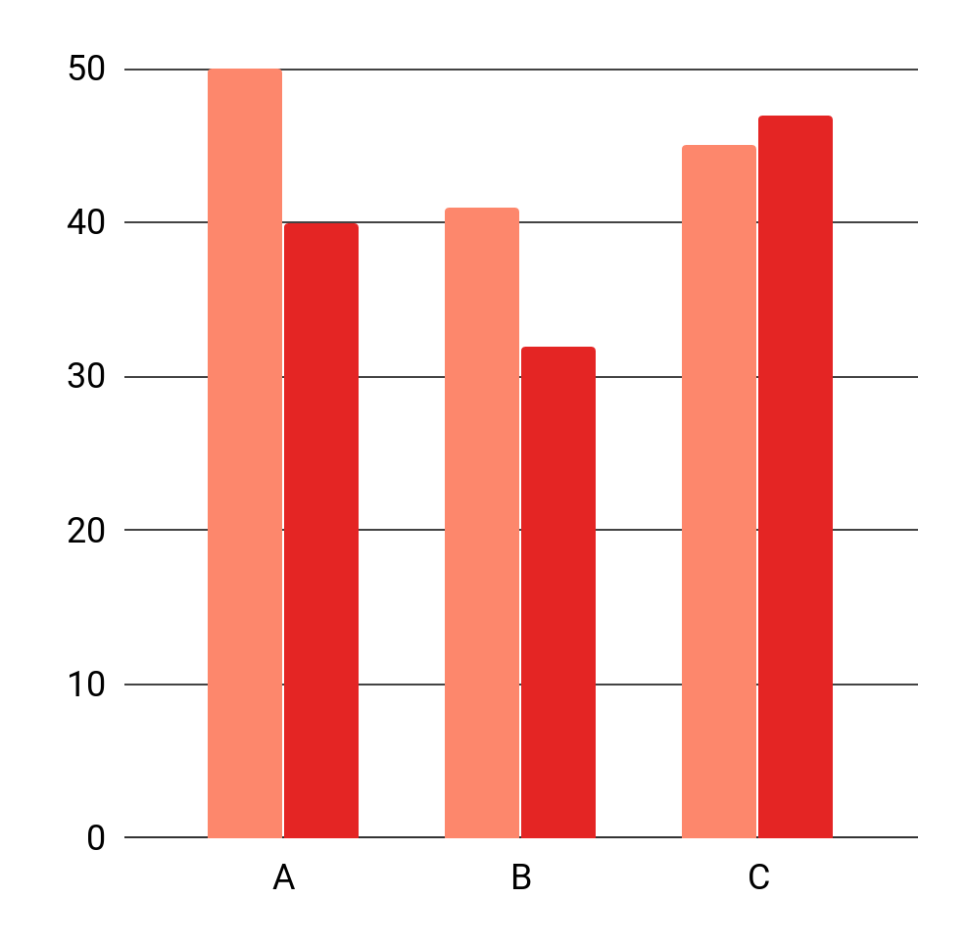
Exploratory
Data Analysis
03
The data has 82 columns which include 23 nominal, 23 ordinal, 14 discrete, and 20 continuous variables (and 2 additional observation identifiers)

Slide 6
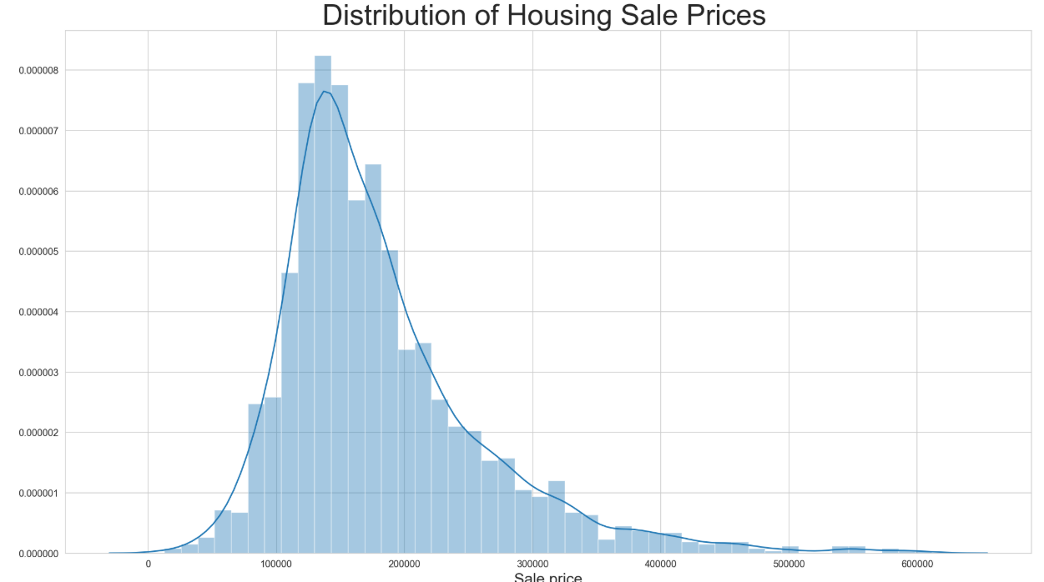
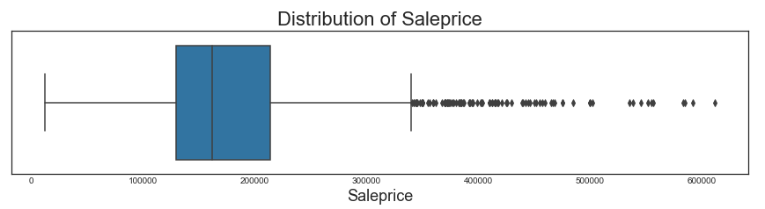
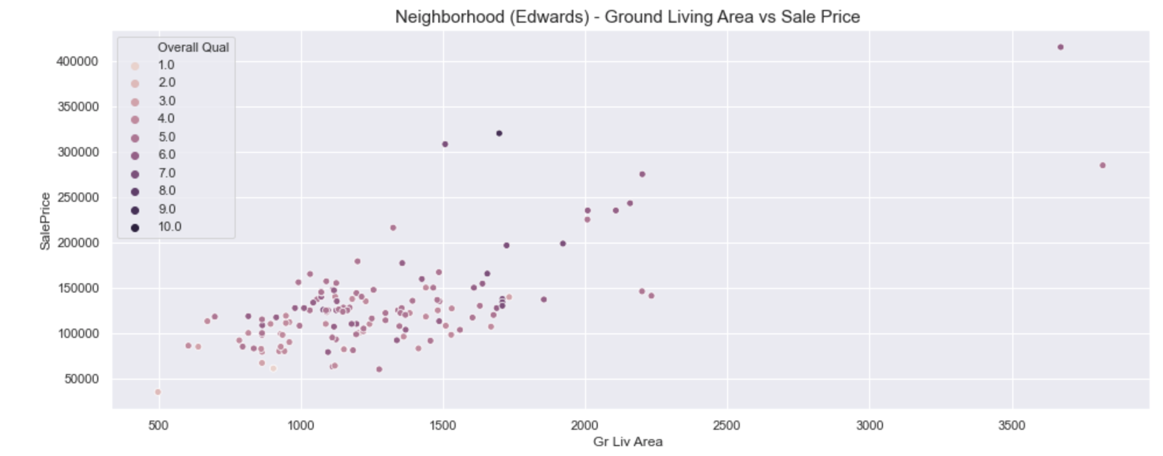
Outliers
Mean: 181,469
Point at 5 standard deviations away

Slide 7
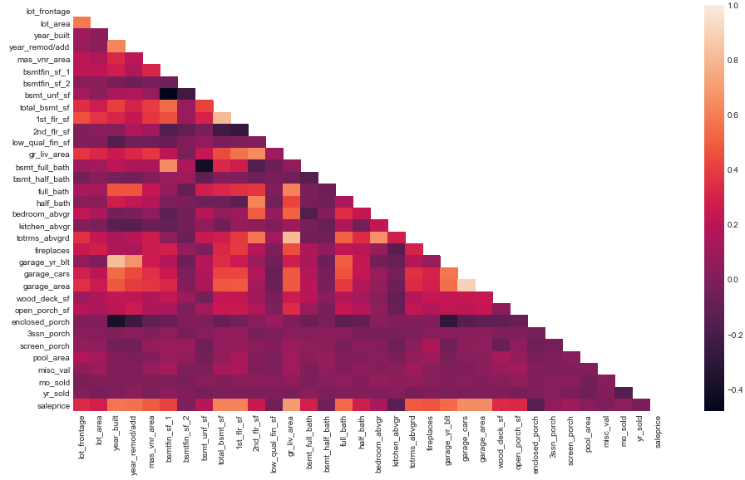
Heatmap of Numerical variables
Some variables are collinear
A number of variables have moderate and strong correlation to sale price

Slide 8
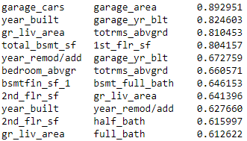
Collinear Variables
Selection process to identify representative variable, e.g
garage_area over garage_cars due to better granularity
Year_built over garage_yr_blt as logic would suggest garages are built at the same time as when the property is built

Slide 9
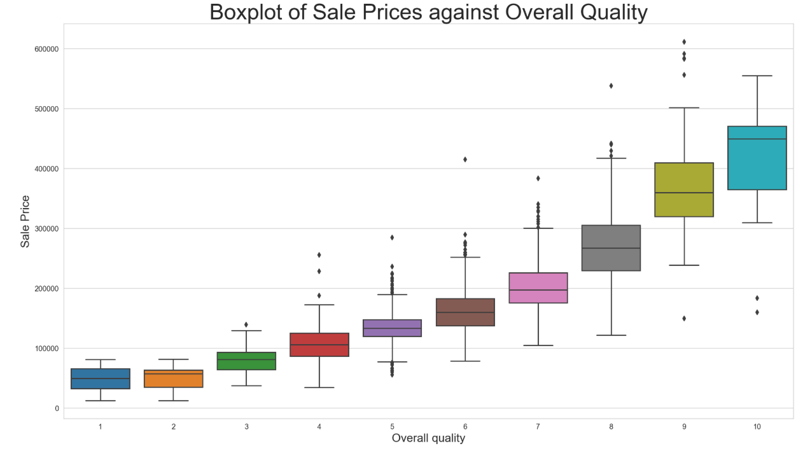
A house with a better overall quality finish always results in higher prices
SALE PRICE AGAINST OVERALL QUALITY

Slide 10
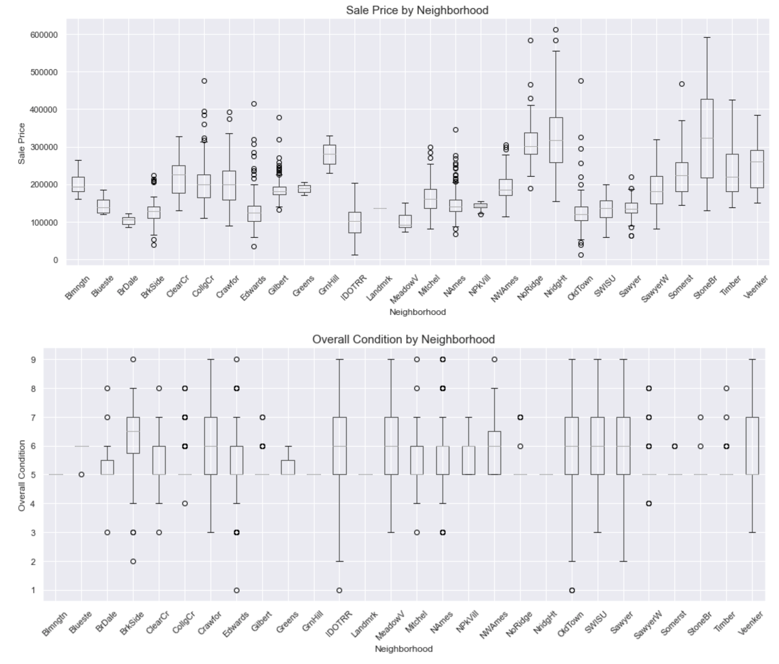
SALE PRICE AGAINST NEIGHBOURHOOD
From this graph, we see that despite of the overall condition of the property, people were willing to pay a premium for locations. Eg. Properties in North Ridge Heights, North Ridge and Stone Brook.
Whereas locations such as Brookside, despite of better overall condition commanded a low sale price.

Slide 11
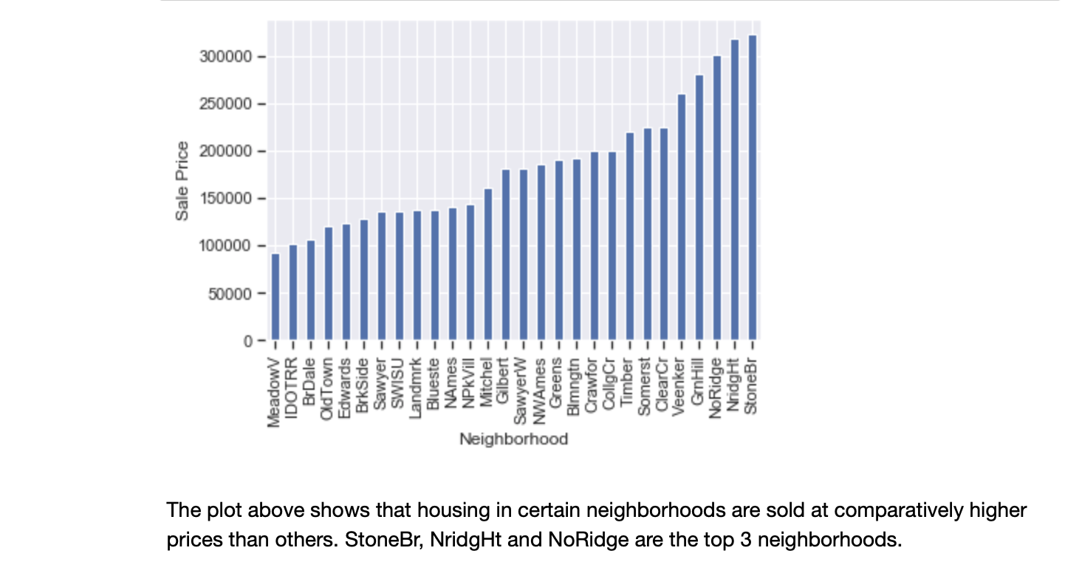
SALE PRICE AGAINST NEIGHBOURHOOD
Notes:
Do we still want to keep this slide?

Slide 12
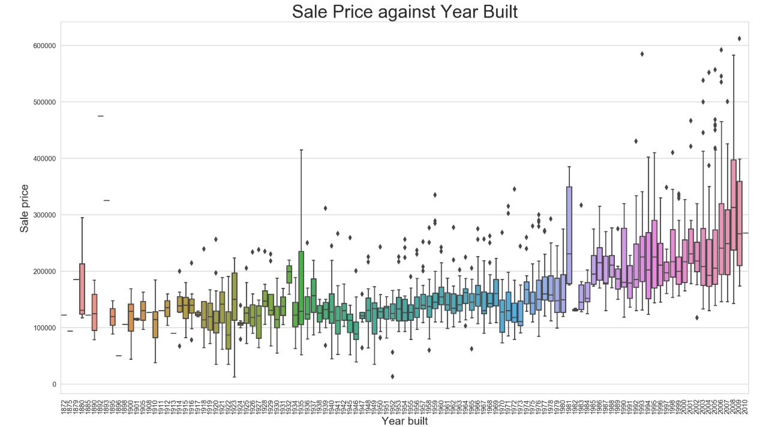
There is a general trend of increases house prices over the years. 2 reasons to explain this trend:
Inflation of Prices
Newly Built houses will cost more; less depreciation compared to older houses.
SALE PRICE AGAINST YEAR BUILT

Slide 13
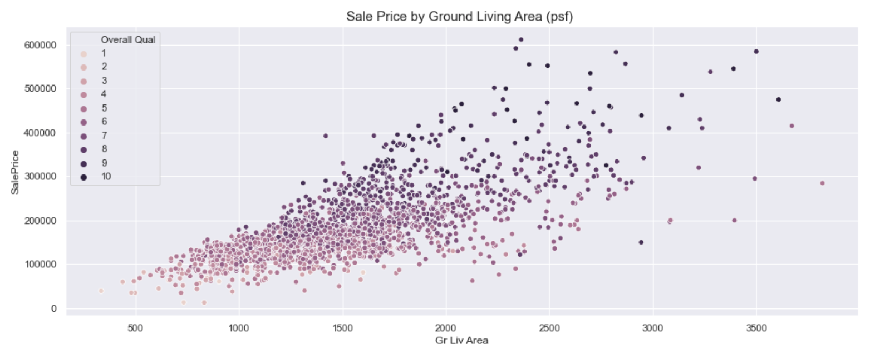
SALE PRICE AGAINST GROUND LIVING AREA & OVERALL QUALITY
There is a strong positive correlation between ground living area and sale price.
More living space would generally result in higher prices.

Slide 14
Feature Engineering
04

Slide 15
INTERACTION TERMS
Total number of bathrooms
Total Sq feet
Neighborhood North cluster
Located near golf courses and lakes
Full Bath + Bsmt Full Bath + 0.5*Half Bath + 0.5*Bsmt Half Bath
Ground Living Area
+
Total Basement
Stone Brook
+
North Ridge
+
North Ridge Heights

Slide 16
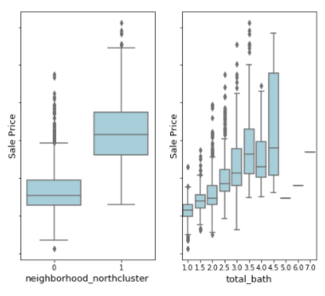
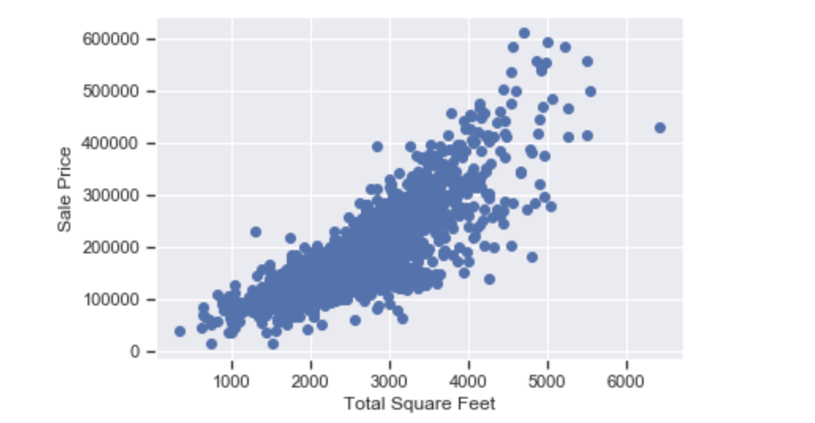
INTERACTION TERMS
Someone pls paste your scatter plot here if you have one
Total number of bathrooms
Total Sq feet
Neighborhood North cluster
Notes:
Boxplots: Interaction terms show higher median sale price as we move along the x-axis

Slide 17
Mapping for Ordinal Variables
Excellent->5
Good->4
Typical->3
Fair->2
Poor->1

Slide 18
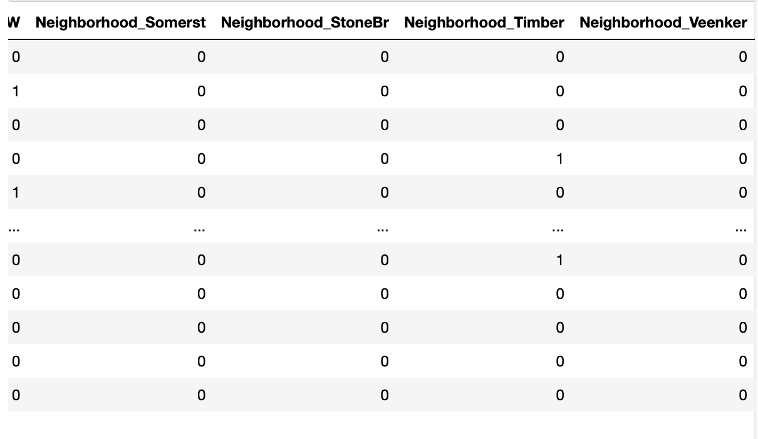
OHE for Categorical Variables
final_features = pd.get_dummies(features).reset_index(drop=True)
Notes:
What one hot encoding does is, it takes a column which has categorical data, which has been label encoded and then splits the column into multiple columns. The numbers are replaced by “1” and “0”, depending on which column has what value

Slide 19
Evaluation of Regression Models
05

Slide 20
RMSE: $79,435
Baseline model
Set all predictions to be the sale price mean from the the training dataset

Slide 21
CROSS VALIDATION AND REGULARIZATION
Linear Regression
Lasso
Ridge
Elastic Net
R2: 0.90 RMSE: 24,800
R2: 0.90 RMSE: 24,700
R2: 0.90 RMSE: 24,759
R2: 0.86 RMSE: 29,462
Best parameters: {'alpha': 3.2, 'l1_ratio': 0.8}
Hyperparameters selected using GridSearch

Slide 22
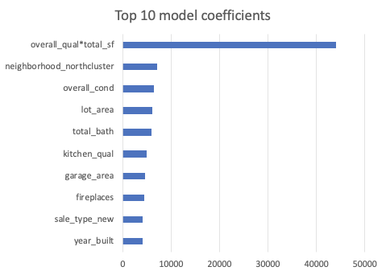
TOP 10 LASSO MODEL COEFFICIENTS

Slide 23
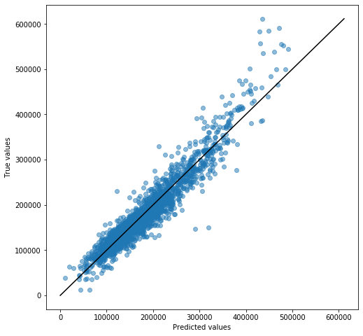
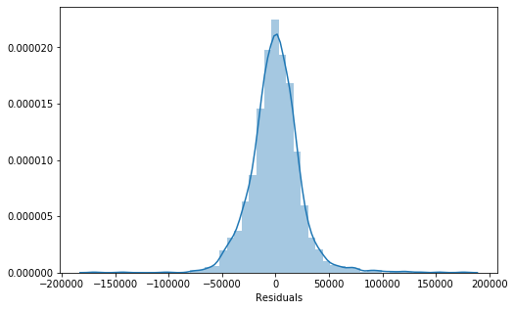
INFERENTIAL VISUALIZATIONS
Residuals are normally distributed with mean 0
Model does well in predicting houses that were priced within the low to moderate range. However, the model tends to underestimate house at higher prices.

Slide 24
Conclusion
06

Slide 25
IN CONCLUSION
01
02
Lasso is the model most able to meet our objectives
The top 3 predictors, including interaction features: overall_qual*total_sf, neighborhood_northcluster and overall_cond

